Slide 1

Algebra 1
Unit 9, Lesson 9 Solving Quadratics Using the Quadratic Formula Volume 2, pg. 103

Slide 2


Benchmark
MA.912.AR.3.1
Given a mathematical or real-world context, write and solve one-variable quadratic equations over the real number system.
volume 2, pg. 103

Slide 3
Integrated Mathematical Thinking and Reasoning Standards
MA.K12.MTR.3.1 Complete tasks with mathematical fluency.
MA.K12.MTR.5.1 Use patterns and structure to help understand and connect mathematical concepts.
volume 2, pg. 103

Slide 4

Learning Target
I can solve a quadratic using the quadratic formula.
volume 2, pg. 103

Slide 5

Warm-Up
volume 2, pg. 103

Slide 6
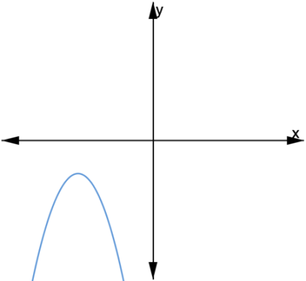
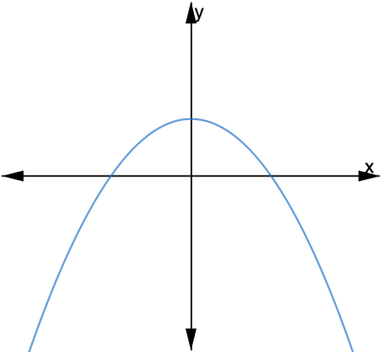
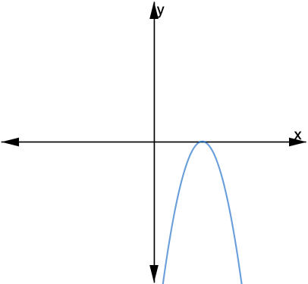
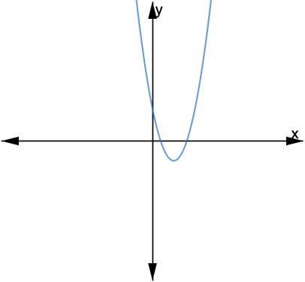
9.9.1 Warm-Up: Which One Doesn’t Belong?
Four different parabolas are shown. Choose one graph that does not belong and explain your choice using key features.
volume 2, pg. 103
Notes:
Video Link: https://algebranation.wistia.com/medias/fi4fidi5y8

Slide 7

Guided Instruction
volume 2, pg. 104

Slide 8

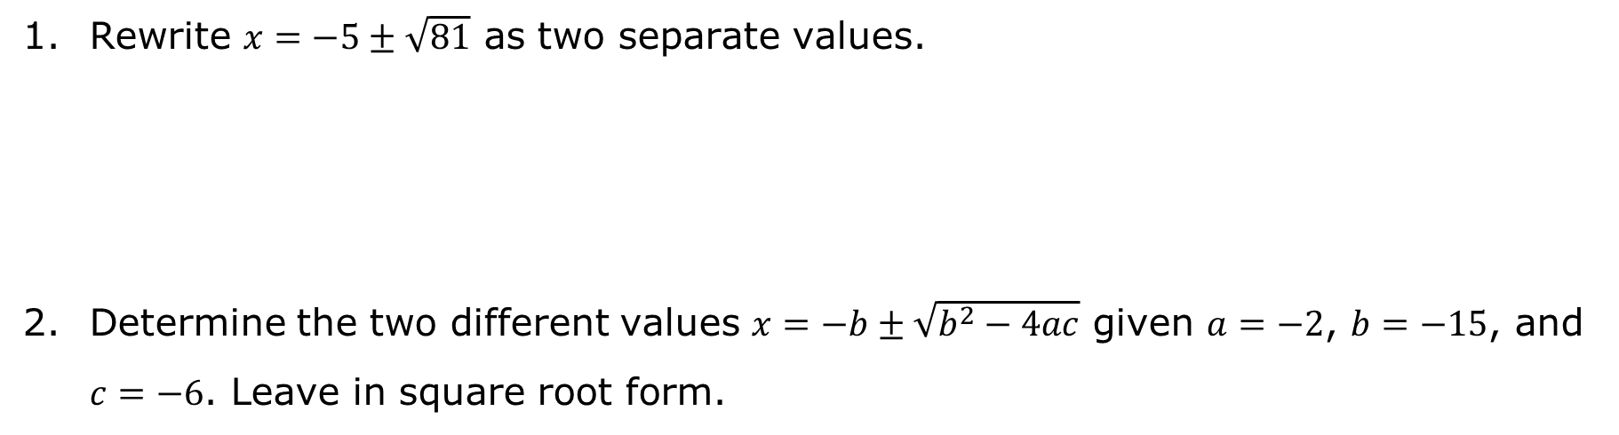
9.9.2 Guided Instruction: Quadratic Formula
Rewrite $x=−5±\sqrt{81}$ as two separate values.
Determine the two different values $x=−b±\sqrt{b^{2}−4ac}$ given $a=−2$, $b=−15$, and $c=−6$. Leave in square root form.
volume 2, pg. 104

Slide 9

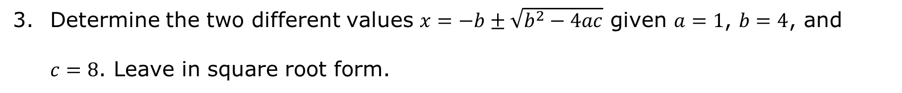
Determine the two different values $x=−b±\sqrt{b^{2}−4ac}$ given $a=1$, $b=4$, and $c=8$. Leave in square root form.
The square root of a negative number is a non‑real value.
volume 2, pg. 104

Slide 10
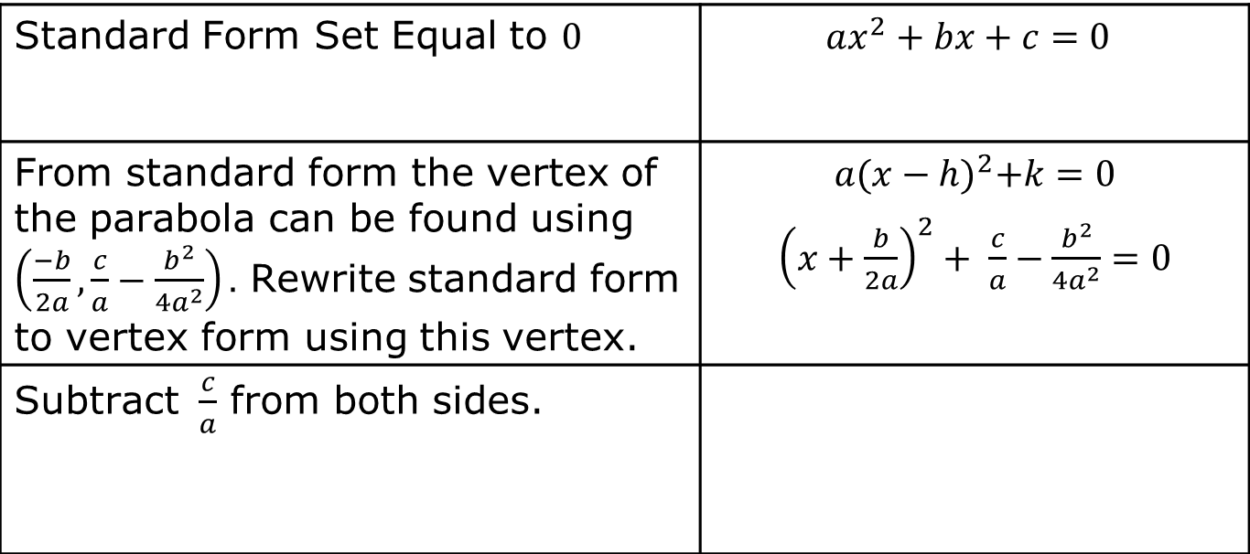
Solving quadratics when given standard form is similar to isolating the variable 𝑥 from standard form, except that standard form is set equal to $0$.
Standard Form Set Equal to $0$ | $$ax^{2}+bx+c=0$$
From standard form the vertex of the parabola can be found using $\left(\frac{−b}{2a},\frac{c}{a}−\frac{b^{2}}{4a^{2}}\right).$ Rewrite standard form to vertex form using this vertex. | $$a{(x−h)}^{2}+k=0$$ ${\left(x+\frac{b}{2a}\right)}^{2}+ \frac{c}{a}−\frac{b^{2}}{4a^{2}}=0$
Subtract $\frac{c}{a}$ from both sides.
volume 2, pg. 104

Slide 11
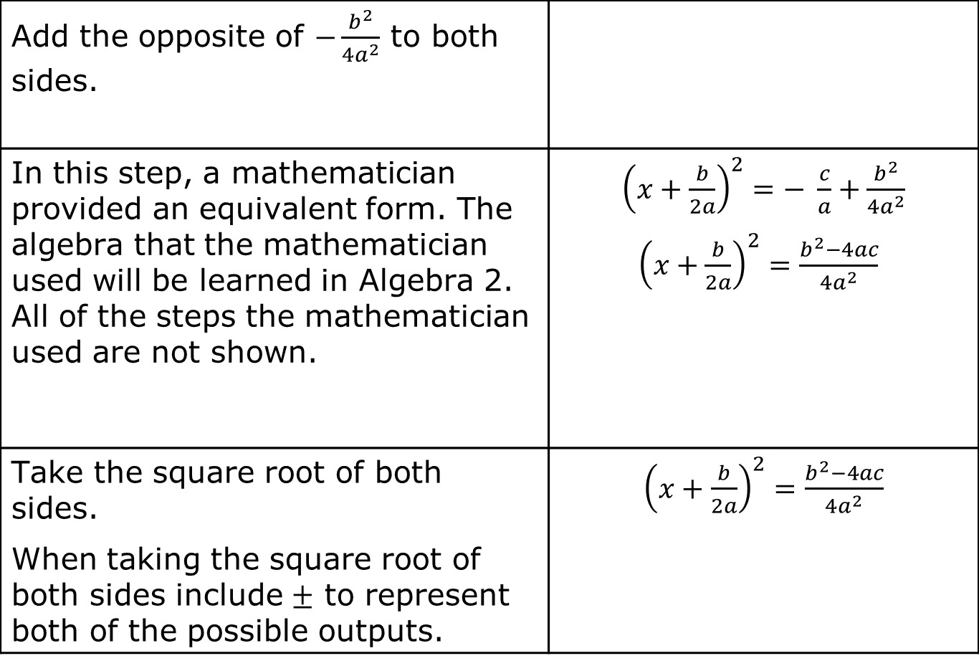
Add the opposite of $−\frac{b^{2}}{4a^{2}}$ to both sides.
In this step, a mathematician provided an equivalent form. The algebra that the mathematician used will be learned in Algebra 2. All of the steps the mathematician used are not shown. | ${\left(x+\frac{b}{2a}\right)}^{2}=− \frac{c}{a}+\frac{b^{2}}{4a^{2}}$ ${\left(x+\frac{b}{2a}\right)}^{2}=\frac{b^{2}−4ac}{4a^{2}}$
Take the square root of both sides. When taking the square root of both sides include $±$ to represent both of the possible outputs. | ${\left(x+\frac{b}{2a}\right)}^{2}=\frac{b^{2}−4ac}{4a^{2}}$
volume 2, pg. 104

Slide 12
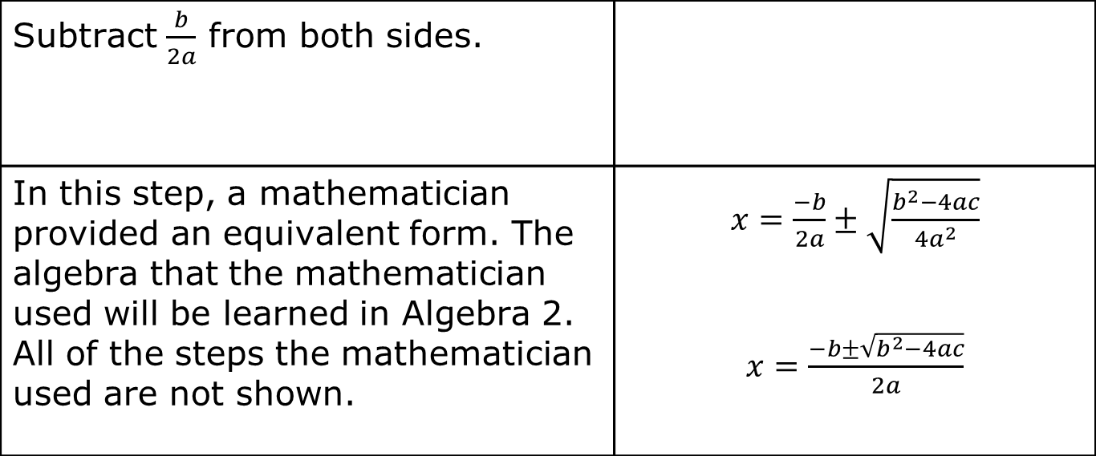
Subtract $\frac{b}{2a}$ from both sides.
In this step, a mathematician provided an equivalent form. The algebra that the mathematician used will be learned in Algebra 2. All of the steps the mathematician used are not shown. | $x=\frac{−b}{2a}±\sqrt{\frac{b^{2}−4ac}{4a^{2}}}$ $x=\frac{−b±\sqrt{b^{2}−4ac}}{2a}$
volume 2, pg. 105

Slide 13

By isolating the variable 𝑥, a formula for solving any quadratic in standard form that is set equal to $0$ was created. This formula is called the quadratic formula.
Quadratic Formula
$$x=\frac{−b±\sqrt{b^{2}−4ac}}{2a}$$
The quadratic formula is used to solve a quadratic in standard form that is set equal to $0$, $ax^{2}+bx+c=0$.
volume 2, pg. 105

Slide 14
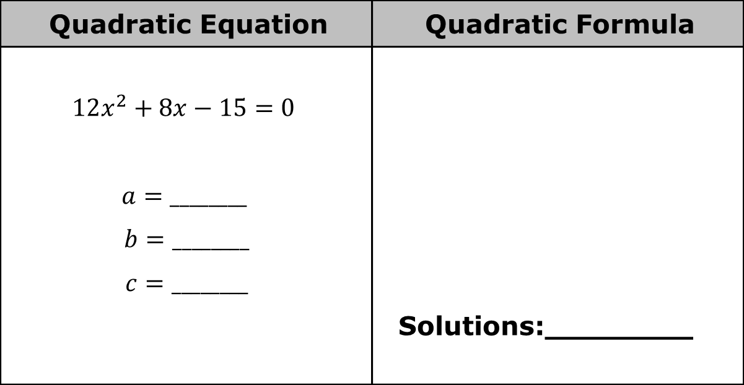
Complete the table.
Quadratic Equation | Quadratic Formula
$$12x^{2}+8x−15=0$$ $$a=________$$ $$b=________$$ $$c=________$$ | Solutions:________
volume 2, pg. 105

Slide 15
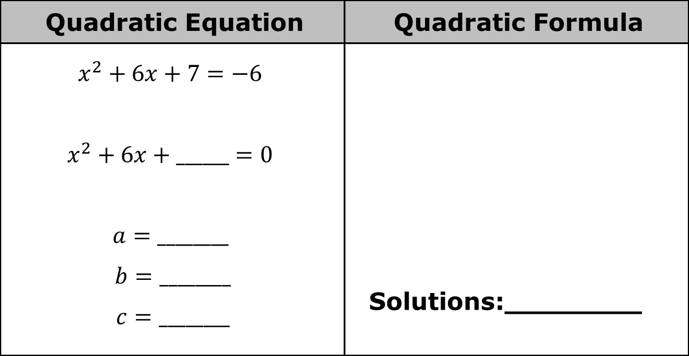
Quadratic Equation | Quadratic Formula
$$x^{2}+6x+7=−6$$ $$x^{2}+6x+______=0$$ $$a=________$$ $$b=________$$ $$c=________$$ | Solutions:________
volume 2, pg. 105

Slide 16

Quadratic Equation | Quadratic Formula
$${−5x}^{2}−5x+18=4x+17$$ $${−5x}^{2}____ ____x____ ____=0$$ $$a=________$$ $$b=________$$ $c=________$ | Solutions:________
volume 2, pg. 105

Slide 17

Try It
volume 2, pg. 106

Slide 18
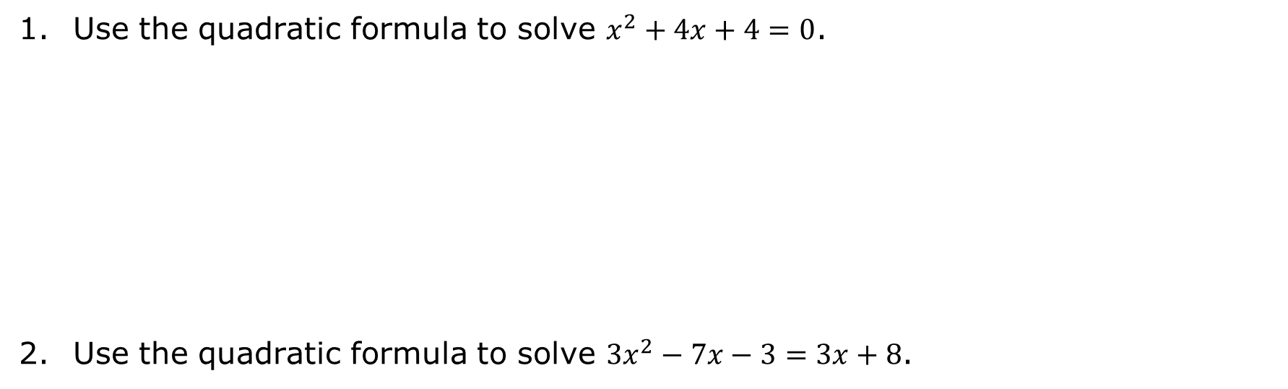
9.9.3 Try It: Solving With the Quadratic Formula
Use the quadratic formula to solve $x^{2}+4x+4=0$.
Use the quadratic formula to solve $3x^{2}−7x−3=3x+8$.
volume 2, pg. 106

Slide 19

Your Turn
volume 2, pg. 106

Slide 20
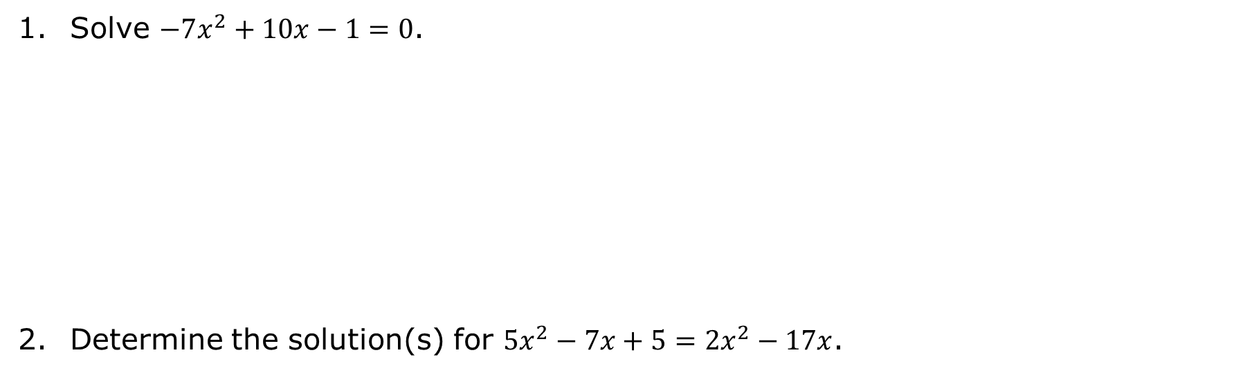
9.9.4 Your Turn!
Solve $−7x^{2}+10x−1=0$.
Determine the solution(s) for $5x^{2}−7x+5=2x^{2}−17x$.
volume 2, pg. 106

Slide 21

Wrap-Up
volume 2, pg. 107

Slide 22
9.9.5 Wrap-Up: Reflection
Complete the learning pyramid.
One question I would like to have answered …
One mistake I learned from today …
One thing I am not sure about … YET!
One thing I am confident I know is …
volume 2, pg. 107

